Slide 1

Building Trust in Educational AI through Factuality Verification​
Data Jackets
Georgia Institute of Technology

Slide 2

Agenda
Business Problem Framing
Analytics Problem Framing
Data
Methodology Selection
Model Building
Deployment
Life Cycle Management
Conclusion
2

Slide 3
Business Problem
1. Business Problem Framing
LLM hallucinations affect user trust and adoption of educational AI tools.​
Supporting Data:​
Strong negative sentiments associated with hallucinations ^{[1]​}
More than 50% of surveyed students are concerned ^{[2]​}
People becoming more cautious and selective in using AI ^{[3]​}
3

Slide 4
Stakeholder Analysis
1. Business Problem Framing
Stakeholder​ | Primary Concern​ | Secondary Concerns​
Students​ | Reliable responses ^{[4]​} | Price and speed​ ^{[7]​}
Educators​ | Limiting misinformation ^{[5]​} | Product accessibility​ ^{[8]}
Platforms | Reputational risk ^{[6]​} | Product competitiveness ^{[9]}
4

Slide 5
Problem Formulation
1. Business Problem Framing
How can we increase user trust in educational AI tools by accurately, quickly and cost-effectively identifying erroneous/ irrelevant (“hallucinated”) LLM responses within the next two months?
Primary Metric: Accuracy
Secondary Metric: Cost and Speed
5

Slide 6
Analytics Problem
2. Analytics Problem Framing
Inputs: | Question + Context + Answer
Output:​ | Label (factual/ contradiction/ irrelevant)
Analytics Problem: | Predictive Problem Text Classification based on Factuality and Relevance
Assumptions: | Context is relevant to the question.​ The question has an answer.​
Constraints: | Limited time, compute resources​ Use only free services
Risk Mitigation: | Class imbalance → Balanced accuracy​
6

Slide 7
Metrics and Goals
2. Analytics Problem Framing
Primary Metric: Balanced Accuracy
Secondary Metrics: Average Time and Cost per Run
 | Balanced Accuracy | Average Time per Run | Average Cost per Run
Baseline​ (no solution) | 33.3% | 0.0s | $0.00
Target | 95.0% | 3.0s | $0.01
Stretch Goal | 99.5% | 1.0s | $0.001
7

Slide 8
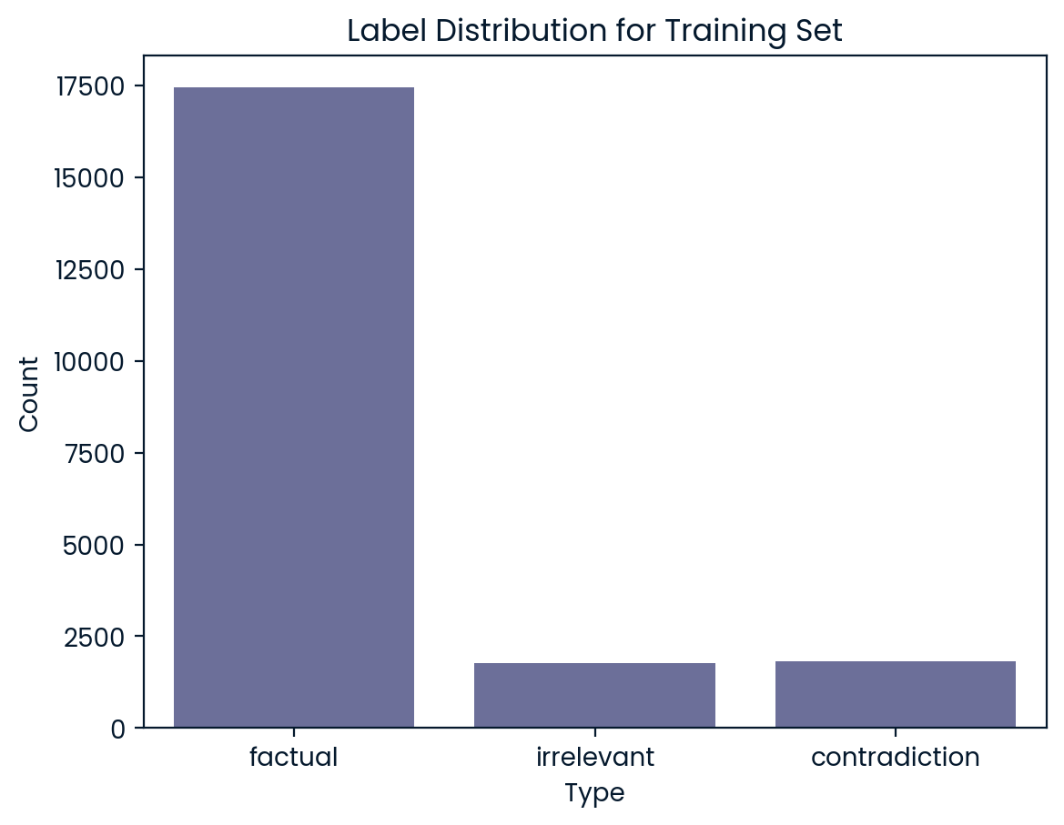
Overview of Data
3. Data
21,021 training samples
2,000 held-out test samples
No ethical issues involved
Large class imbalance in the training set
8

Slide 9
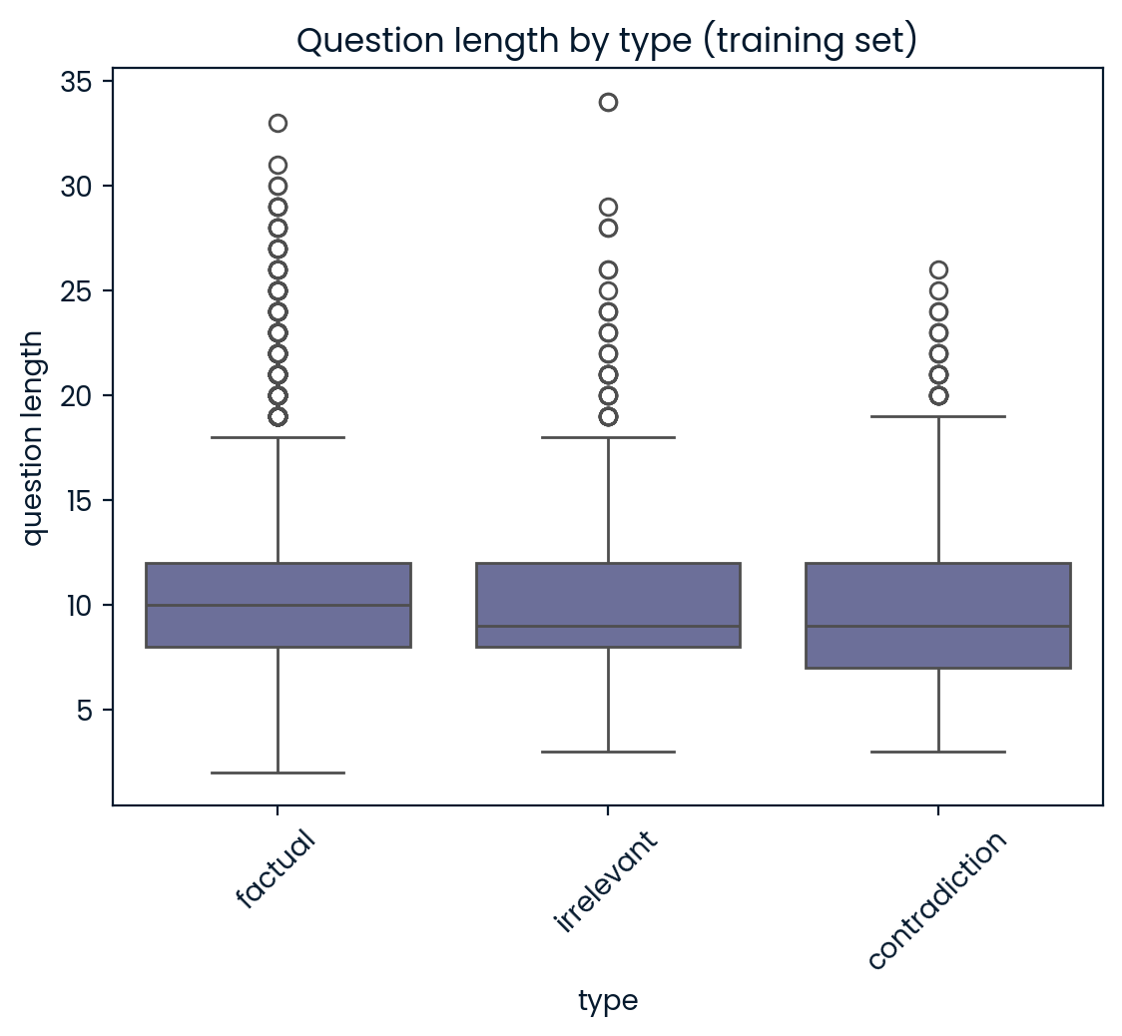
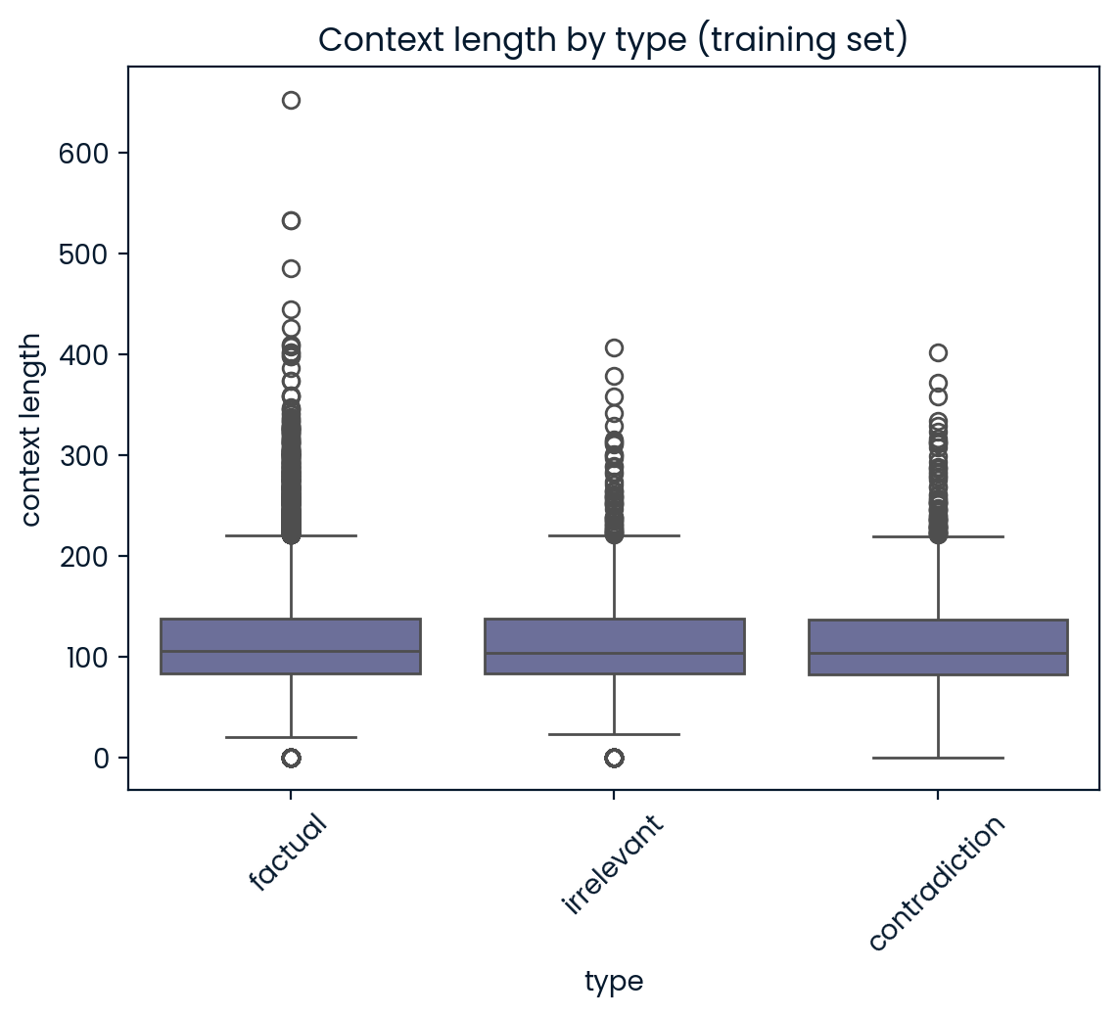
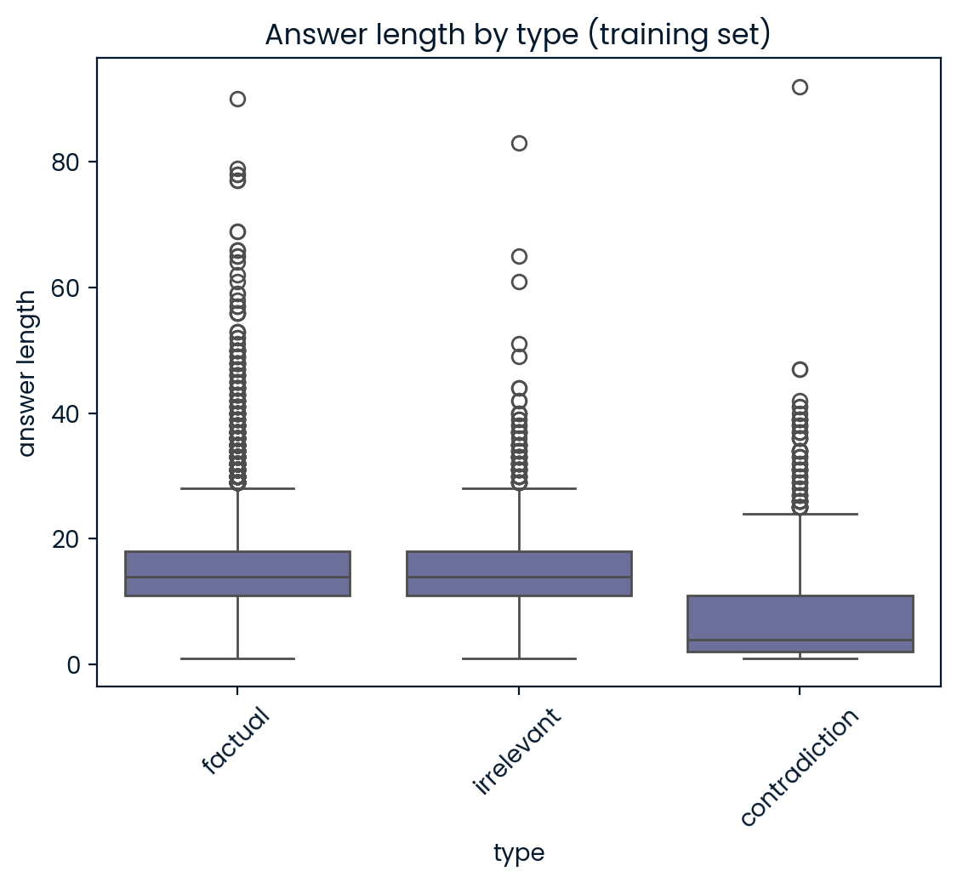
Length-Based Analysis
3. Data
Answers for contradictions are significantly shorter than factual/ irrelevant types
9

Slide 10
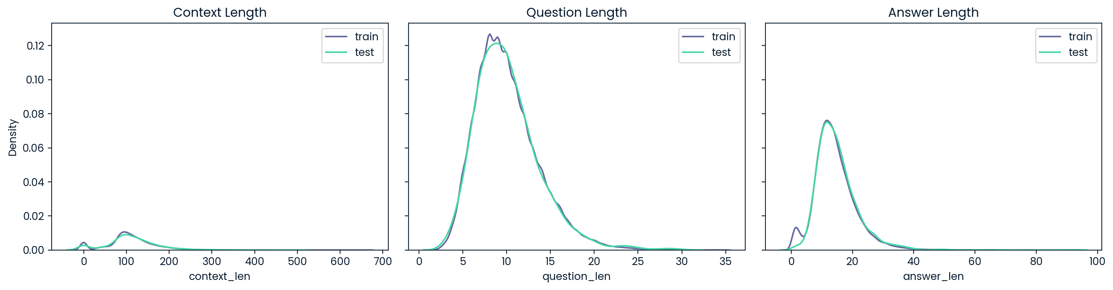
Train-Test Drift
3. Data
Length-based feature distributions are similar, except that the training set includes many short answers absent from the test set
10

Slide 11
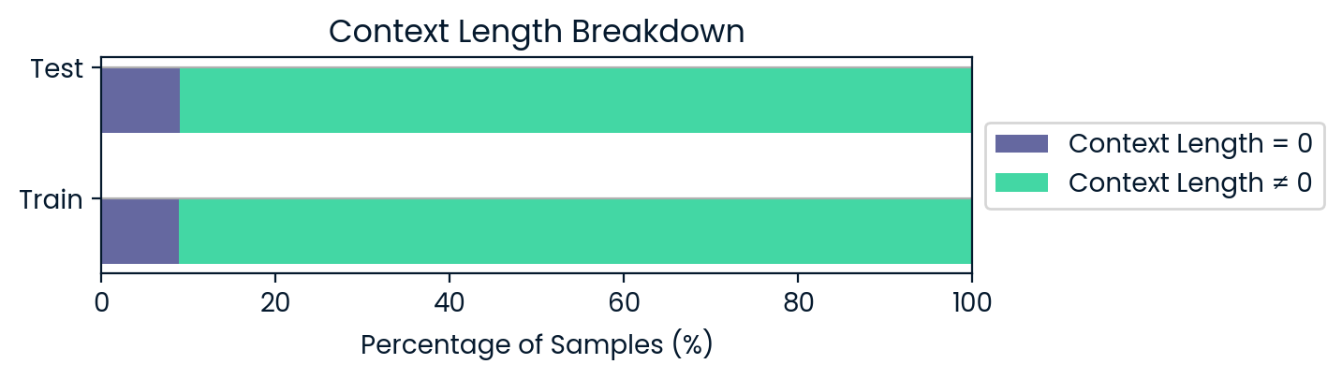
Context Adequacy
3. Data
A significant minority (~8-9%) of data in both datasets have no context
All nonzero contexts with < 25 words were manually checked for adequacy
11
Notes:
35 in train set, 2 in test set

Slide 12
Initial Approach
4. Methodology Selection
Cite some past literature on semantic similarity for factuality detection
Derived semantic similarity between the question, answer and context
Expectation:
Factual answer shares keywords with question and context → high similarity
Irrelevant answer is misaligned with question and context → low similarity
Contradictory answer → somewhere in between
12

Slide 13
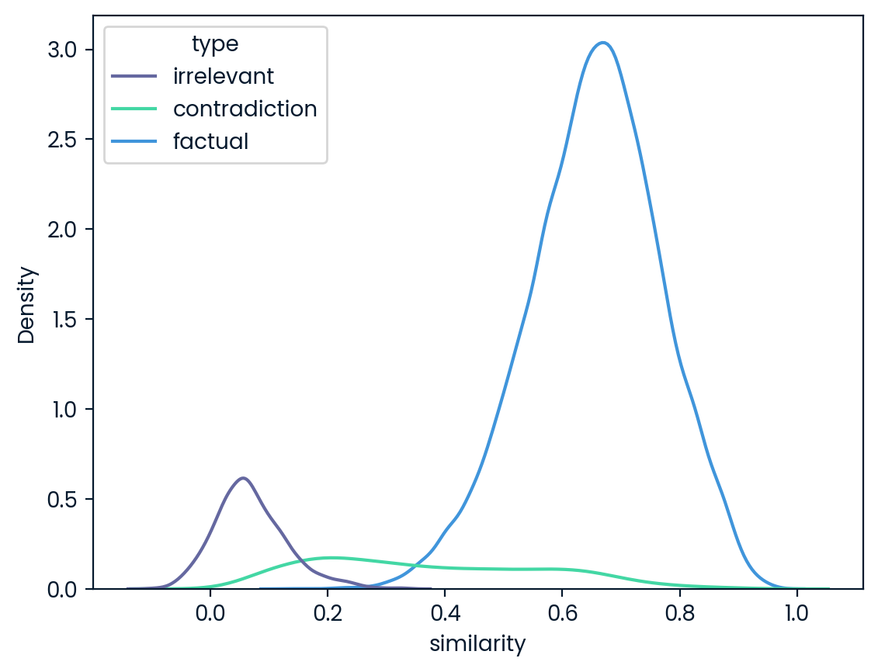
Results from EmbeddingGemma[] Model
4. Methodology Selection
13
Notes:
We can see a neat separation between the irrelevant and factual responses, but the similarity scores of the contradictions span a wide range of values.

Slide 14
Explanation of Results
4. Methodology Selection
Short answers (eg. "six months", "2") have minimal semantic similarity with the question and context.
They just happened to be predominantly contradictions in the training set.
14
Notes:
We can see a neat separation between the irrelevant and factual responses, but the similarity scores of the contradictions span a wide range of values.

Slide 15
Explanation of Results
4. Methodology Selection
Answers to questions with empty contexts yielded high similarity scores even when they were contradictory.
There is no context to counterbalance the semantic alignment between the question and answer.
15
Notes:
We can see a neat separation between the irrelevant and factual responses, but the similarity scores of the contradictions span a wide range of values.

Slide 16
Reframing the Analytics Problem
2. Analytics Problem Framing
Cases with context:
Evaluate answer factuality/ relevance with respect to the question + context.
Cases with no context:
Evaluate answer factuality/ relevance with respect to the question + external knowledge.
16

Slide 17
Final Approach
4. Methodology Selection
Cite some past literature on these methods for factuality detection
We need to reason about factuality and relevance
Our approach incorporates:
MNLI* Model | Premise-Hypothesis structure allows logical reasoning Premise = Context + Question | Hypothesis = Answer
LLM-as-a-judge | LLMs have strong semantic reasoning capabilities
*Multi-Genre Natural Language Inference
17

Slide 18
Data with No Context
4. Methodology Selection
Additional procedures were applied to no-context cases:
MNLI Model | Context augmentation from an external source
LLM-as-a-judge | Modified LLM prompt with amended decision rule
18

Slide 19
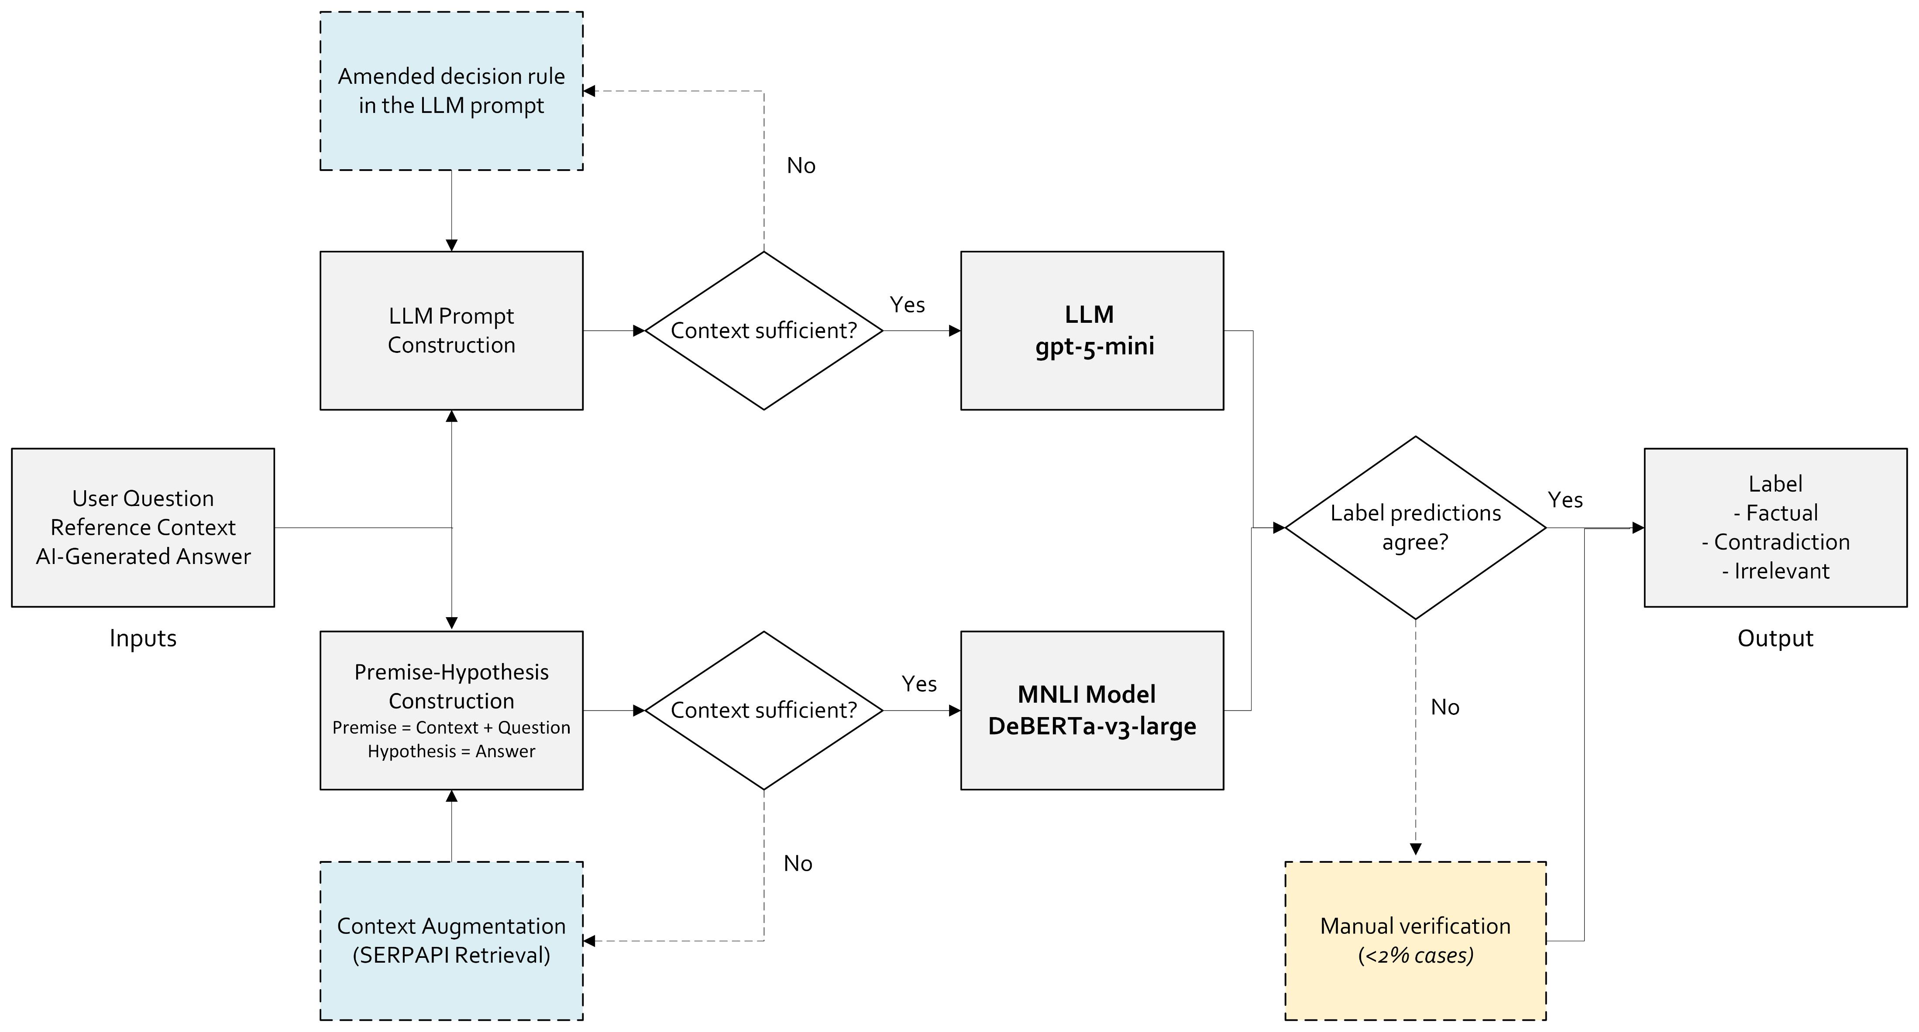
Data Analytics Pipeline
5. Model Building
19

Slide 20
MNLI Model
5. Model Building
20

Slide 21
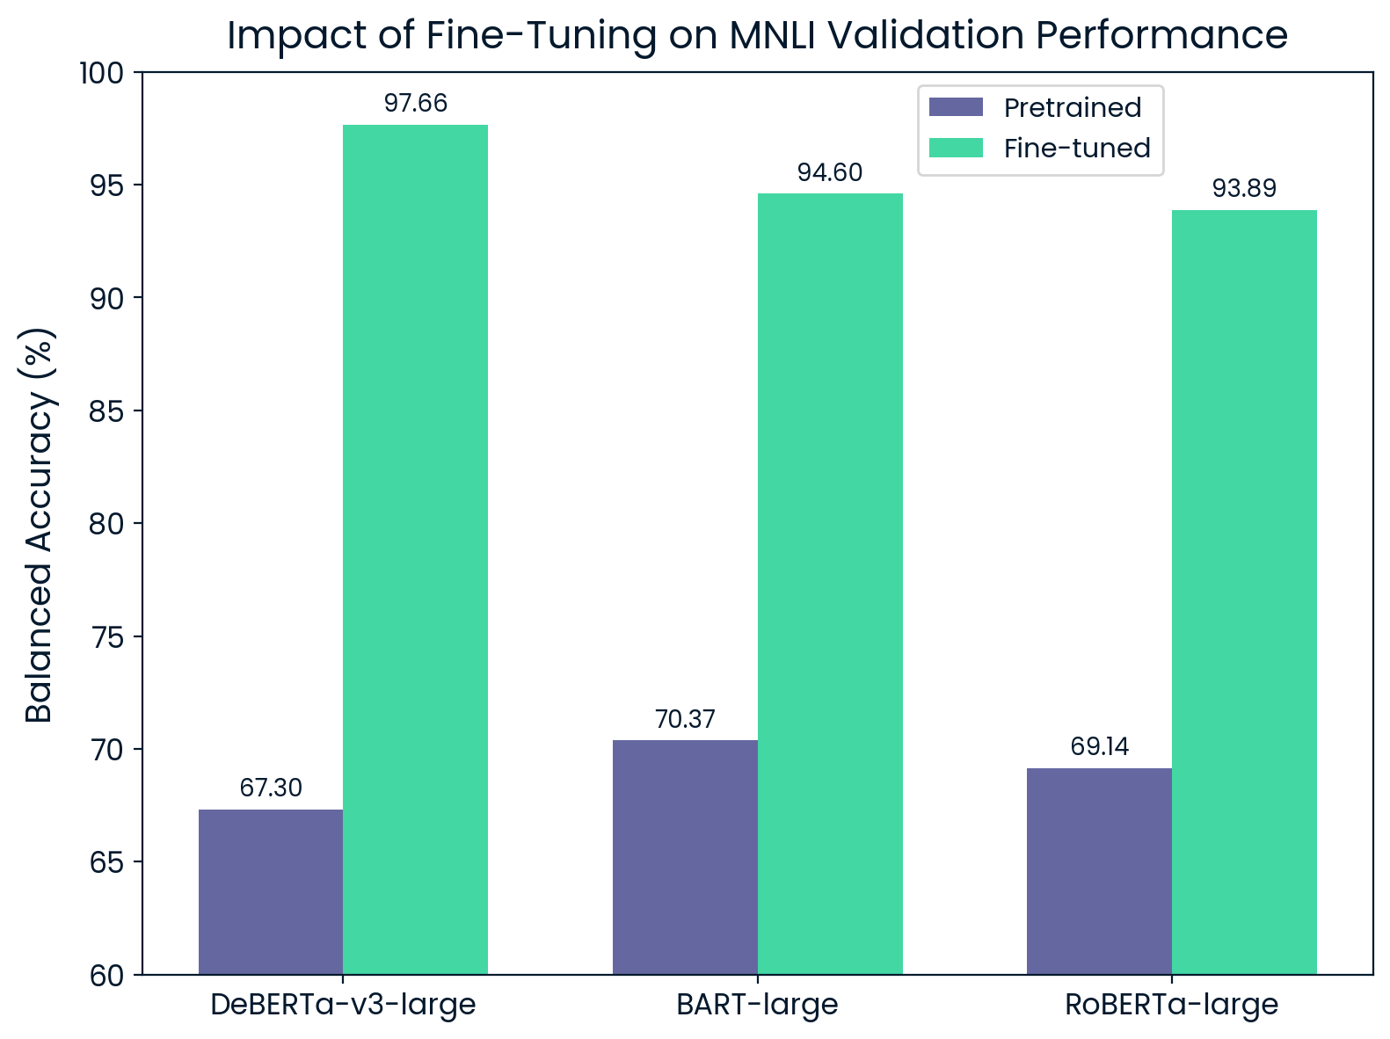
MNLI Model Selection
5. Model Building
Procedure:
Stratified 80/10/10 split of train set
We compared validation performance (balanced accuracy) of several pretrained and fine-tuned models
Results:
Fine-tuned DeBERTA-v3-large gave the best validation performance
Unbiased test bal. accuracy: 97.70%
Fine-tuning yields ~25-30% gains
For the final competition submission, models were retrained on the full training dataset.
21

Slide 22
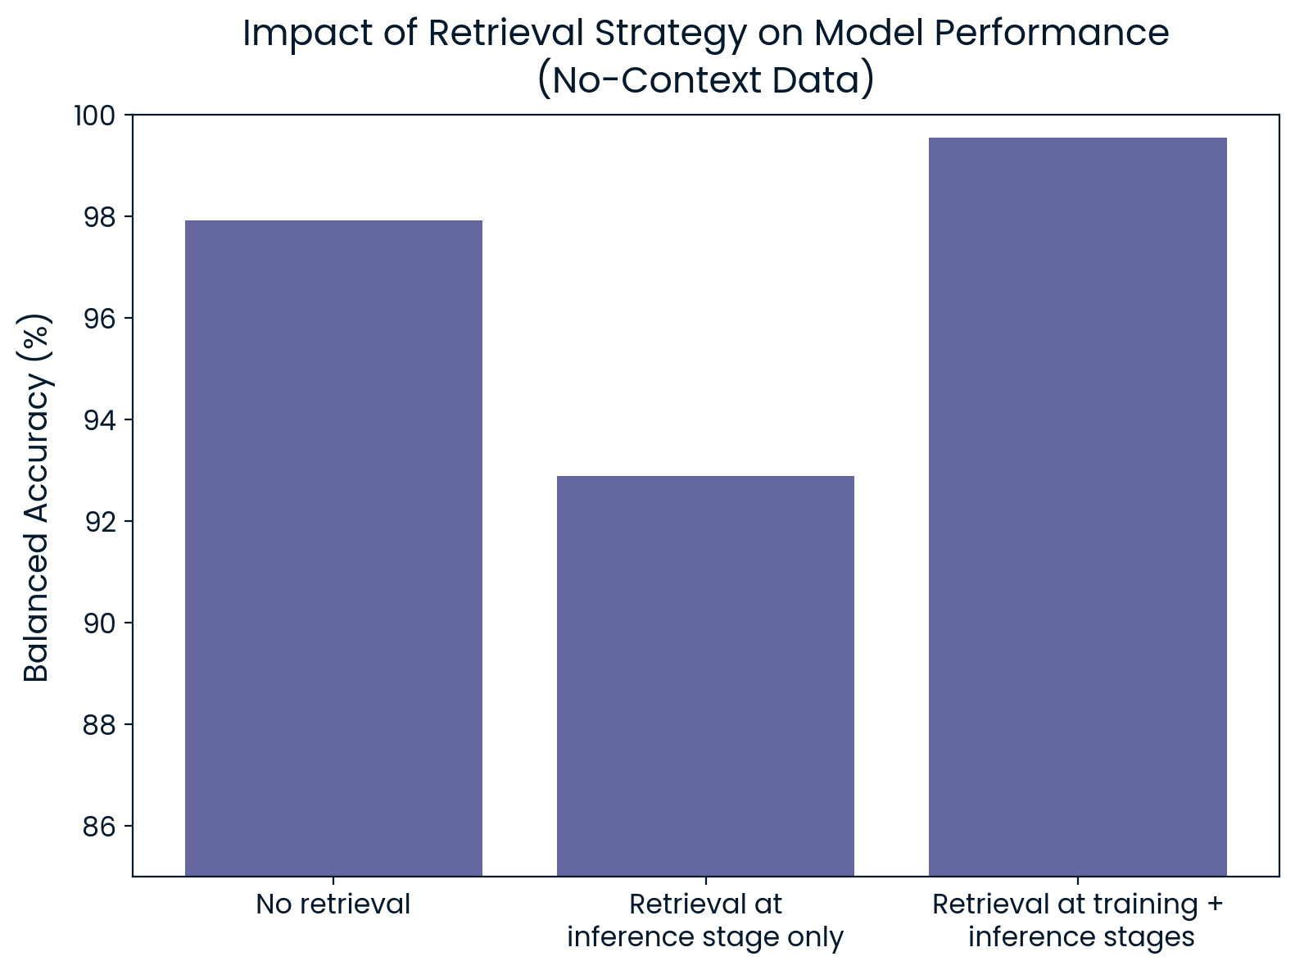
Context Augmentation with SERPAPI
5. Model Building
Procedure for no-context data:
We passed in the question as a search query and retrieved the first paragraph of Google Search Overview result
We then compared performance of different strategies on the test split
Results:
External retrieval (SERPAPI) helps only when model is trained on it
Retrieval-aware training exposes the model to similar input distributions
22

Slide 23
Large Language Model
5. Model Building
23

Slide 24
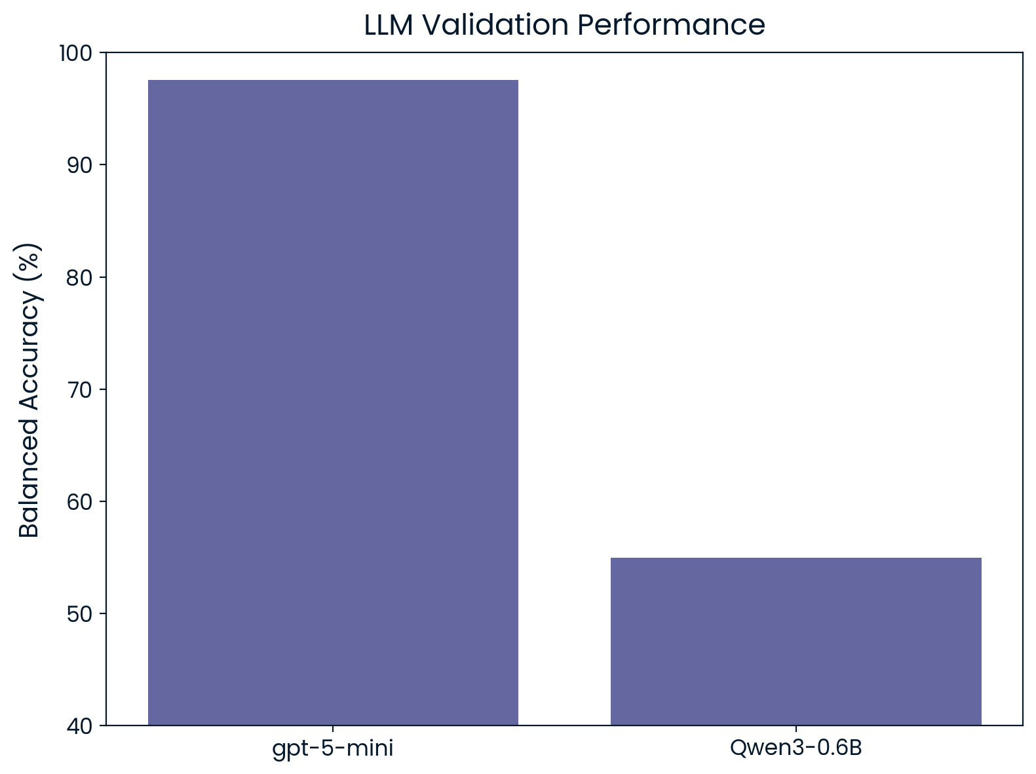
LLM Selection
5. Model Building
Procedure:
LLMs were prompted to classify data with clear decision rules (modified for the cases with no context)
Same validation and test split as before
Results:
Azure OpenAI’s gpt-5-mini gave the better validation performance
Unbiased test bal. accuracy: 98.96%
24

Slide 25
Ensemble
5. Model Building
25

Slide 26
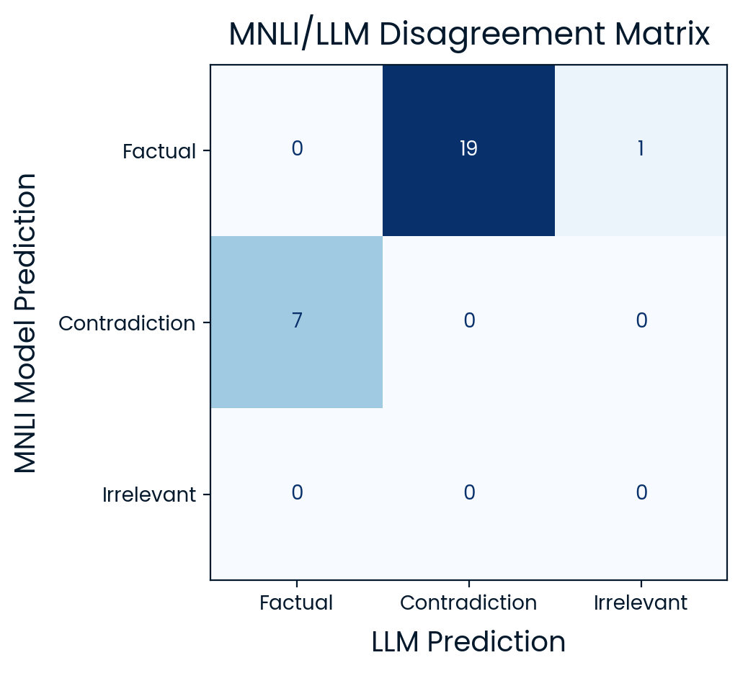
MNLI/LLM Disagreements
5. Model Building
Procedure:
Both models were run on the test split
MNLI/LLM disagreements were identified
Results:
Model disagreements in <2% of cases​ necessitating human review
Disagreements are dominated by factual ↔ contradiction flips​
Failure modes were related to data and task limitations
26

Slide 27
Failure Modes
5. Model Building
Textual nuances driving labeling subjectivity
Example | Answer: In 2006, the population of Tucson was 535,000 SERPAPI Context: The population was an estimated 535,000
Issue | Loss of uncertainty qualifier → Model treats as contradiction
MNLI Model
Ill-posed or underspecified questions
Example | Question: What type of flags are used in foreign countries? Answer: In foreign countries, the Queen uses personal flags
Issue | Scope mismatch → Model treats as contradiction
LLM
27

Slide 28
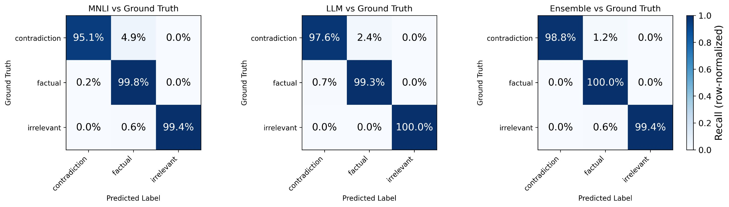
Component-Wise Results
5. Model Building
MNLI Model vs Ground Truth
LLM vs Ground Truth
Ensemble vs Ground Truth
Balanced Accuracy (%) on Test Split
97.70 | 98.96 | 99.38
28

Slide 29
Final Results
5. Model Building
 | Balanced Accuracy | Average Time per Run | Average Cost per Run
Competition Results | 99.03% | 3.0s | $0.006
Target | 95.0% | 3.0s | $0.010
Stretch Goal | 99.5% | 1.0s | $0.001
✅
✅
✅
29

Slide 30
High-Level Process Diagram
6. Deployment
Contradiction/ Irrelevant
🔒
Factuality/ Relevance Gate
User Prompt
AI Output
Factual
User-Facing System
Inadequate Prompt
Our solution acts as a gate for hallucinated responses, ​not just a diagnostic tool
30

Slide 31
Real-World Considerations
6. Deployment
Solution must handle "messy" data that violates our assumptions
Validation can be done through user ratings of AI responses 👍👎
“Messy” Data | Additional Measures
Context is not relevant to question | Update the Models • Additional MNLI fine-tuning • LLM prompt refinement
Question is not answerable
Sensitive private data is passed in | Pre-Screening for Sensitive Data
31

Slide 32
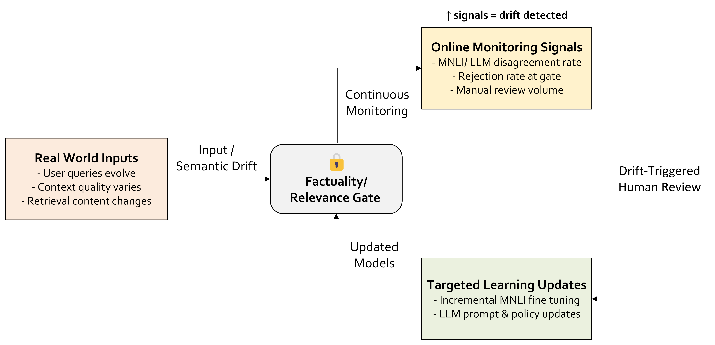
Drift-Aware Operation
7. Life Cycle Management
32

Slide 33
Conclusion​

Slide 34




Revisiting the AI Services Used
Azure OpenAI
(LLM)
Hugging Face
(NLI Models)
Google Colab & Kaggle
(GPU)
34

Slide 35
Key Insight
Trade-Off
Low Accuracy
Low Cost/Time
MNLI Model
(logical reasoning)
Moderate Accuracy
Moderate Cost/Time
LLM-as-a-judge
(rule-based semantic reasoning)
High Accuracy
High Cost/Time
Ensemble Solution
(multi-annotation)
35

Slide 36
Recommendations
#1: Platforms should enable ensemble verification by default
Reason: Stakeholder analysis shows the primary concern is accuracy
Implication: Consumers may face higher costs to use educational AI tools​
But the long-term benefits of user trust will outweigh the slightly higher costs [ref]
#2: Platforms should allow users to opt into less robust MNLI-only verification
This option gives users and platforms flexibility for low-risk use cases
Given “opt-in” nature, most users will stick to default settings anyway [ref]
#3: Platforms should remind users to independently verify matters of high sensitivity
No model is infallible and errors can have serious consequences
36

Slide 37
References
To be added
37

Slide 38
Thank You

Slide 39
Appendix​

Slide 40
LLM Prompts (1/2)
Without Context You are a classification model. Your task is to assign exactly ONE label to an answer given a question. Labels: - "factual": The answer addresses the question and is accurate. - "contradiction": The answer addresses the question but is incorrect. - "irrelevant": The answer is not relevant to the question. |  | With Context You are a classification model. Your task is to assign exactly ONE label to an answer given a context and a question. Labels: - "factual": The answer addresses the question and is supported by the context. - "contradiction": The answer addresses the question but is incorrect or contradicts the context. - "irrelevant": The answer is not relevant to the question.
2

Slide 41
LLM Prompts (2/2)
Without Context Rules: - Output only one of the three labels. - Do not explain your reasoning. Decision procedure: 1. If the answer does not address the question, label "irrelevant". 2. If the answer addresses the question and is correct, label "factual". 3. If the answer addresses the question and is incorrect, label "contradiction". |  | With Context Rules: - Use only the information provided in the context. - Do not use outside knowledge. - Output only one of the three labels. - Do not explain your reasoning. Decision procedure: 1. If the answer does not address the question, label "irrelevant". 2. If the answer addresses the question and is supported by the context, label "factual". 3. If the answer addresses the question but is contradicted by the context, label "contradiction".
2

Slide 42
Cost and Time Calculations
 | MNLI Model | SERPAPI | gpt-5-mini | Human Verification | Total
Data | 100% | 10% | 100% | 2% | -
Time​ | 0.05s (self-tested) | 1.0s (self-tested) | 1.8s (self-tested) | 1.2s (self-tested) | 3.0s
Cost | $0.0073/1K (using the Azure NC4as T4 v3 GPU) | $1/1K (SERPAPI Big Data Subscription) | $0.0794/1K (Azure OpenAI Documentation) | $4.8/1K (assuming $15/hr labor costs) | $5.88/1K
7

Slide 43
Cost and Time Calculations
 | MNLI Model | SERPAPI | gpt-5-mini | Human Verification | Total
Time​ | 0.05s (self-tested) | 1.0s (self-tested) | 1.8s (self-tested) | 1.2s (self-tested) | 3.0s
Cost (per 1K) | $0.0073 (using the Azure NC4as T4 v3 GPU) | $1.00 (SERPAPI Big Data Subscription) | $0.0794 (Azure OpenAI Documentation) | $4.80 (assuming $15/hr labor costs) | $5.88
7

Slide 44
Failure Modes (LLM)
5. Model Building
Contradictions with strong lexical overlap
Example | “Namibia was previously called German South West Africa”
Issue | “German” is an unsupported modifier in the answer
Contradictions with strong lexical overlap
Example | “Namibia was previously called German South West Africa”
Issue | “German” is an unsupported modifier in the answer
27

Slide 45
Cost and Time Calculations (1/2)
Average number of tokens per query to gpt-5 mini = 317.5
Average number of tokens per query to MNLI model = 176.4
Since MNLI+SerpAPI work in parallel with gpt-5 mini we take 2.2s for the both of them
 | MNLI Model | SERPAPI | gpt-5-mini | Human Verification | Total
Time​ | 0.05s | 1.0s | 1.8s | 1.2s | 3.0s
Cost | $0.0073/1K | $1/1K | $0.0794/1K | $4.8/1K | $5.88/1K
7

